Slide 1
FPGA-Accelerated Simulation Technologies (FAST)
Derek Chiou
University of Texas at Austin
Electrical and Computer Engineering

Slide 2
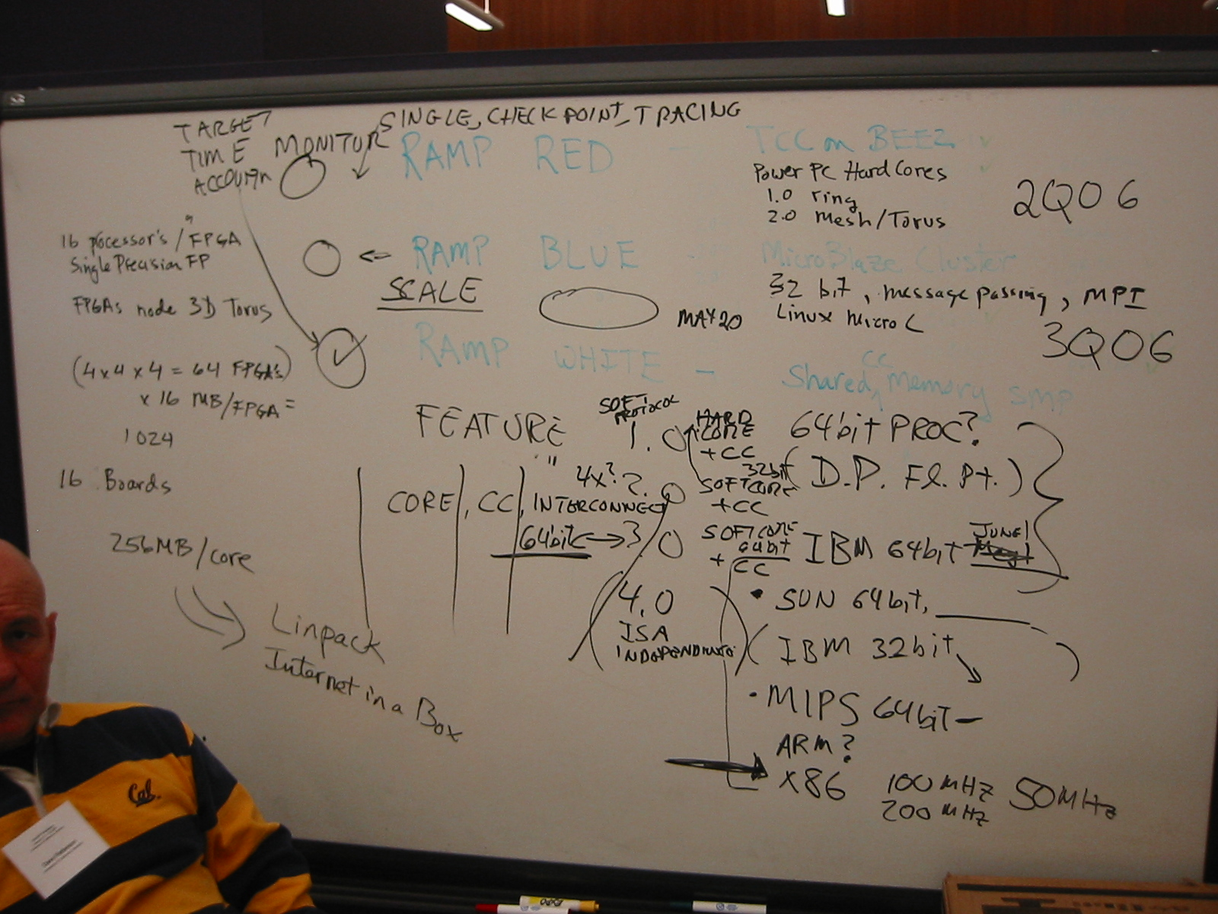
An Early Picture
December 2005, Berkeley

Slide 3
RAMP Project Timeline
Wash
Texas
Stanford
Intel/MIT
Prototypes
Simulators
CMU
Wavescalar
Prototype: Implement target system in FPGAs
Every register/gate in target is in prototype
Port ASIC RTL to FPGAs or develop RTL for FPGAs
Time scaled prototype
Delay transactions to adjust relative times
E.g., delay memory requests/replies to model slower memory
Simulator: Implement model of target in FPGAs
Not every target register/gate
May be very different than target
Split functional/timing
Analytical model
But predicts the performance of target, executes code
RAMP-Red
2005
FAST
HAsim
2006
RAMP-Blue
RAMP-White
Protoflex
2007
Purple
2008
RAMP-Gold
2009
2010

Slide 4
My First RAMP Retreat talk: Confessions of a RAMP Heretic
Most Pre-RAMP efforts were prototypes
Initial RAMP thrust was time scaled prototype
FAST has always been a simulator, not a prototype
Wanted to be able to simulate complex target ISAs, micro-architectures, single threaded but also lots of cores, REAL SOFTWARE
Use real ISA as baseline to avoid non-research software infrastructure
Tradeoff simulation performance for accuracy
Perfect (RTL-level) accuracy
Question: how fast can simulators of computers run?
Must be parallelized
Must include hardware
How can simulators be efficiently accelerated by hardware at
Reasonable (approach software simulator) effort
Reasonable hardware
RAMP-White was to be a host platform on which to run FAST

Slide 5
Sim Parallelization: How To Partition and How to Map?
Fetch
iTLB
L1
L2
Memor
y
Paritioning on target module boundaries requires balanced speed of each simulation component, fast, balanced communication
Either purely
software (slow)
hardware (hard)
Is a hybrid hardware/software possible?
Decode
Rename
RS
Br
ALU
dTLB
L1
ROB
Fetch
iTLB
L1
L2
Decode
Rename
RS
Br
ALU
dTLB
L1
ROB
Host 0
CPU
Host 1
CPU
Host 2
CPU
Host
FPGA

Slide 6
Functional/Timing Partitioned
Inst stream
Functional
Model
(ISA)
Timing
Model
(Micro-architecture)
Full-System
Simulator
FPGA
Functional model could be
Pure software (QEMU, Bochs, Simics, SimNow)
Many optimization techniques (e.g., just-in-time compilation)
No better hardware for executing ISA than processor
Makes adding instructions trivial
Pure Hardware (Hoe et al)
Hybrid (Hoe et al)
Timing model is simplified, can be easily implemented in hardware

Slide 7
Such Partitioning is Normally Tightly Coupled for Accuracy
Functional
Model
Functional Information
Timing
Model
Fetch
Perform
Fetch
BP
Fetch
Decode
Src/dest regs
Decode
Renaming
Execute
Opcode
Execute
Delay based on opcode
Memory
virtual/physical address
Memory
Model loads/stores, $
Writeback
Dest reg
Writeback
Free register. Could pass from decode
If Functional Information target correct, can model timing perfectly
Traditional accurate simulators (TD) have TM trigger FM to execute
in target correct order: requires tight coupling of FM and TM

Slide 8
FAST: Functional Model Speculatively Executes, First Generates Trace
Functional Information
Timing
Model
IP
BP
Fetch
Src/dest regs
Decode
Renaming
Func
Model
(ISA)
Opcode
Execute
Delay based on opcode
virtual/physical address
Memory
Model loads/stores, $
Dest reg
Writeback
Free register. Could pass from decode
However, functional information is incorrect

Slide 9
FAST: Wrong Path (Branch Misprediction) Instructions
Functional Information
Timing
Model
M[R1]=R0
BP
Fetch
R0=R0+1
Decode
Renaming
R0=M[R1]
BRz L1
R0=R0+1
L1: M[R1]=R0
BRz L1
Execute
Delay based on opcode
R0=M[R1]
Memory
Model loads/stores, $
-----
Writeback
Free register. Could pass from decode

Slide 10
FAST: Wrong Path (Branch Misprediction) Instructions
Functional Information
Timing
Model
12: R0=R0+1
13
13: M[R1]=R0
Fetch
11: BRz 13
11: BRz 13
Decode
Renaming
10: R0=M[R1]
11: BRz 13
12: R0=R0+1
13: M[R1]=R0
10: R0=M[R1]
Execute
Delay based on opcode
-----
Memory
Model loads/stores, $
-----
Writeback
Free register. Could pass from decode
What if BP mis-predicted? Timing dependent

Slide 11
FAST: Memory Reorderings
Functional Information
Timing
Model
----
BP
Fetch
M[20]=0
Decode
Renaming
R0=M[R1]
BRn L1
R0=R0+1
L1: M[R1]=R0
BRz L1
Execute
Delay based on opcode
R0=M[20]
Value=1
Memory, Value = 0
Model loads/stores, $
-----
Writeback
Free register. Could pass from decode
Value-based (not order based) technique for arbitrary
memory models, data speculation, faults, branch misprediction

Slide 12
FAST Technique: Speculative Functional First
Oracles enables functional model executing first to be accurate
Target Memory Oracle (TMO)
Functional store values passed in trace
By the time stores executed by TM, values have been corrected to being target correct
Branch predictor
SFF enables independent optimization of FM/TM
FM has no micro-architectural knowledge
E.g., no need for register renaming
Can be implemented in software using best software functional techniques
Can be aggressively parallelized with no loss in accuracy
Can be implemented in hardware by providing trace/correction!
FM provides full functionality (no need to transplant)
TM can be far away, highly optimized for its tasks
Does not do any functionality (though oracles need to be maintained)

Slide 13

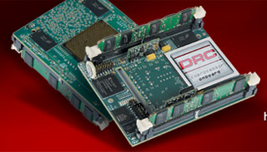
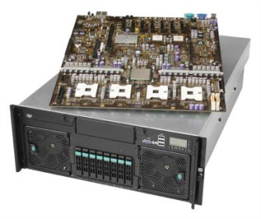
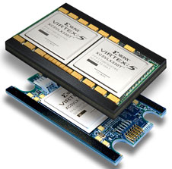
FAST Prototype Overview
Functional
Model
Software
Timing
Model
Bluespec HDL
trace
Xilinx FPGA
Processor
FPGA
PowerPC 405
DRC
Computer
HT
Xilinx/Intel
ACP
FSB
Software (QEMU modified with trace/rollback) functional model
Eventually hardware functional model, but software sim exists
FPGA-based timing model written in Bluespec
Complex OoO micro-architecture fits in a single FPGA
Multiple host cycles

Slide 14
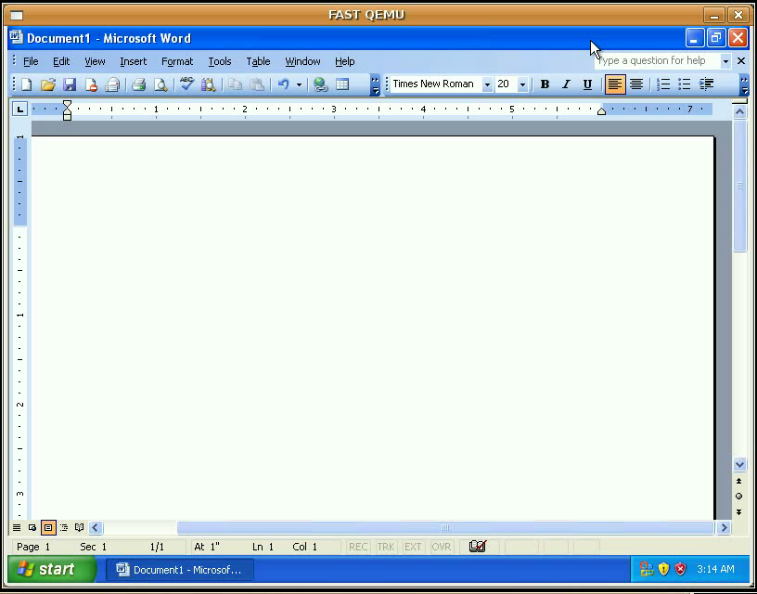
FAST 2007 on DRC in Real Time (~1.2MIPS)

Slide 15
Current Status
Fully parallelized QEMU functional model
Trace, accumulating correction
85%-90% parallel efficiency
~25MIPS with all features on single host core
Target flexibility
Single core target
Multicore target
100MIPS with a 4/6 core host processor + FPGA
~35MIPS/host core with just trace
FPGA platform reliability issues
Starting port to ML605/XUP

Slide 16
SFF FM On Single Host Core Versus Full Simulators

Slide 17
Future of FAST
FAST is continuing at full speed
Dealing with FPGA platform issues
Full system, RTL-level accurate capable, x86 simulator to 4096 cores
Power modeling with Freescale
6% RMS cycle-by-cycle models for Freescale superscalar out-of-order core, ARM A8 (dual issue in-order)
Fault modeling with Intel
FAST2Imp with AMD
Defining better decomposition of processors, memory, network
Will lead to easier to write timing models, better simulators/implementations
Joint research with software academic, will provide highly scalable platform
Pingali (UT), Brooks (Harvard), Sarkar (Rice)
Our own architectural and micro-architectural ideas
NIFD (GDB front end for FPGAs, see Hari for demo)
FAbRIC-based or FAbRIC-like distribution

Slide 18
Big Thanks to
Xilinx for funding/FPGAs
NSF/DOE/SRC for funding
Intel/IBM/Freescale/AMD for funding, equipment, and collaboration
Students (who did all the work)
Hari Angepat, Nikhil A. Patil, Dam Sunwoo
Joonsoo Kim, Ram Chakravarthy Gene Wu, Yi Yuan
And several others

